Slide 1
MapReduce

Slide 2
Contents
What is Big Data?
Big Data Platforms
Brief Introduction on Apache Hadoop and its core components
How MapReduce works?
How Mapper works?
Reducer Tasks

Slide 3
What is BIG-DATA?
Big data is a term that describes the large volume of data – both structured and unstructured – that inundates a business on a day-to-day basis.
It’s not the amount of data that’s important. It’s what organizations do with the data that matters.
Big data can be analyzed for insights that lead to better decisions and strategic business moves.

Slide 4
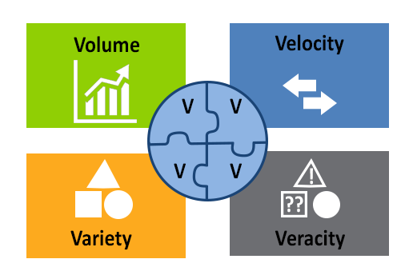
Big Data Using 4 Vs

Slide 5
Data Volume
A typical PC might have had 10 gigabytes of storage in 2000.
Today, Snapchat users share 527,760 photos every minute.
More than 120 professionals join LinkedIn every minute.
Users watch 4,146,600 YouTube videos every minute.
In one minute 456,000 tweets are sent on Twitter.
Instagram users post 46,740 photos.
More than 300 million photos get uploaded per day on Facebook.
Every minute there are 510,000 comments posted and 293,000 statuses updated.

Slide 6
Data Velocity
Clickstream and ad impressions capture user behavior at millions of events per second.
High-frequency stock trading algorithms reflect market changes within microseconds.
Machine to machine processes exchange data between billions of devices.
Infrastructure and sensors generate massive log data in real-time.
On-line gaming systems support millions of concurrent users, each producing multiple inputs per second.

Slide 7
Data Variety
Big Data isn't just numbers, dates, and strings. Big Data is also
Geospatial data
3D data
Audio and video
unstructured text, including log files and social media.
Traditional database systems were designed to address smaller volumes of structured data.

Slide 8
Data Veracity
Biases, noise and abnormality in data.
Is the data that is being stored, and mined meaningful to the problem being analyzed?
Need to have your team and partners work to help keep your data clean.

Slide 9
Horizontal Scaling Vs. Vertical Scaling
Horizontal scaling means that you scale by adding more machines into your pool of resources .
Vertical scaling means that you scale by adding more power (CPU, RAM) to an existing machine.

Slide 10
Big Data Platforms
Hadoop
HDFS
MapReduce
Spark
RDD

Slide 11

"The name my kid gave a stuffed yellow
elephant. Short, relatively easy to spell and
pronounce, meaningless and not used
elsewhere: those are my naming criteria.
Kids are good at generating such."
Doug Cutting, Creator of Hadoop

Slide 12

Hadoop
“Hadoop is the popular open source implementation of MapReduce, a powerful tool designed for deep analysis and transformation of very large data sets.” https://hadoop.apache.org/
It is a software framework for storage and large scale processing of data-sets on clusters of commodity hardware.

Slide 13
When to Use Hadoop?
1. For Processing Really BIG Data.
2. For Storing a Diverse Set of Data.
3. For Parallel Data Processing.

Slide 14
When NOT to Use Hadoop?
1. For Real-Time Data Analysis.
2. For a Relational Database System.
3. For a General Network File System.
4. For Non-Parallel Data Processing.

Slide 15
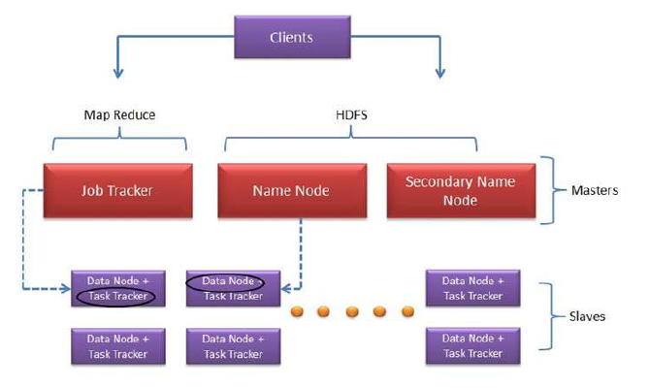
Hadoop Core Components

Slide 16
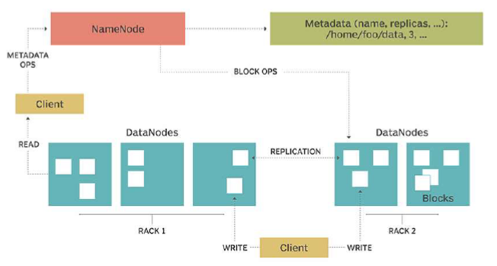
What is HDFS?
HDFS is a distributed file system allowing multiple files to be stored and retrieved at the same time at an unprecedented speed. It is one of the basic components of Hadoop framework.

Slide 17
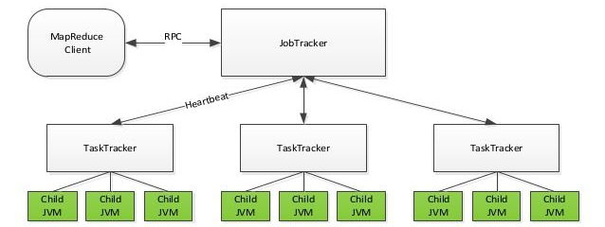
What is Hadoop MapReduce?
Hadoop MapReduce is a programming model or pattern within the Hadoop framework that is used to access big data stored in the Hadoop File System (HDFS). It is a core component, integral to the functioning of the Hadoop framework.

Slide 18




How Mapper Works?
250 Mb File
Data.txt
Block 1 -- > DN1
Block 2 -- > DN2
Number of Mappers == Number of Blocks

Slide 19
Reducers Tasks
• Summarization operation
• By Default One reducer

Slide 20
MapReduce
Map
Mapper Get Data from input File
Write business logic to process data
Write Output
Reduce
Get Data From mapper
Write business logic
Write output

Slide 21
MR Approach
Split Data
Big
Data
Split Data
MAP
Reduce
All
Matches
Split Data
Split Data

Slide 22
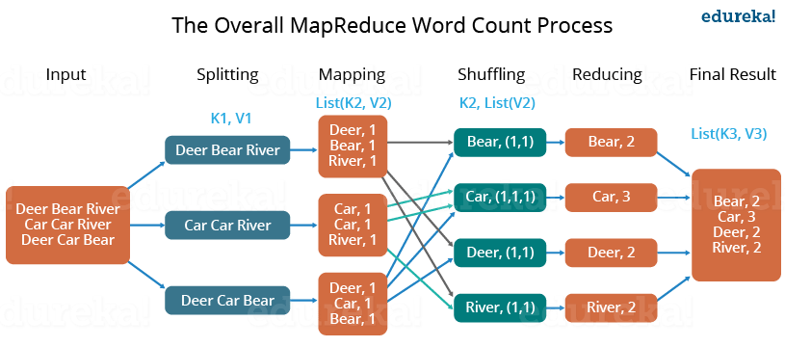
Map Reduce: Word Count

